Slide 1
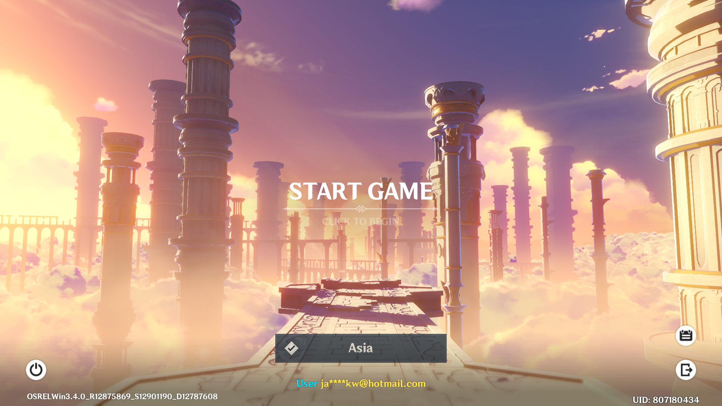
PROJECT GENSHIN
Jason Chuang

Slide 2
PROBLEM STATEMENT
Determine what are the different archetypes using publicly available game data with the aim to help Genshin Impact players know more about themselves and the community. Where possible, the findings could provide some suggestions or tips to the players based on the archetype they belong to.

Slide 3
SAMPLING
Drawing Samples of Gamers
who are playing in the main
three international servers
ASIA
AMERICA
EUROPE
Sample of Gamer UID
whom seek help or help
others from Discord Servers
in January 2023
2,716
2,698
2,195
Success Rate
16.6%
14.4%
16.5%
Achieved Sample
451
389
363
Total Sample Size
1,203

Slide 4
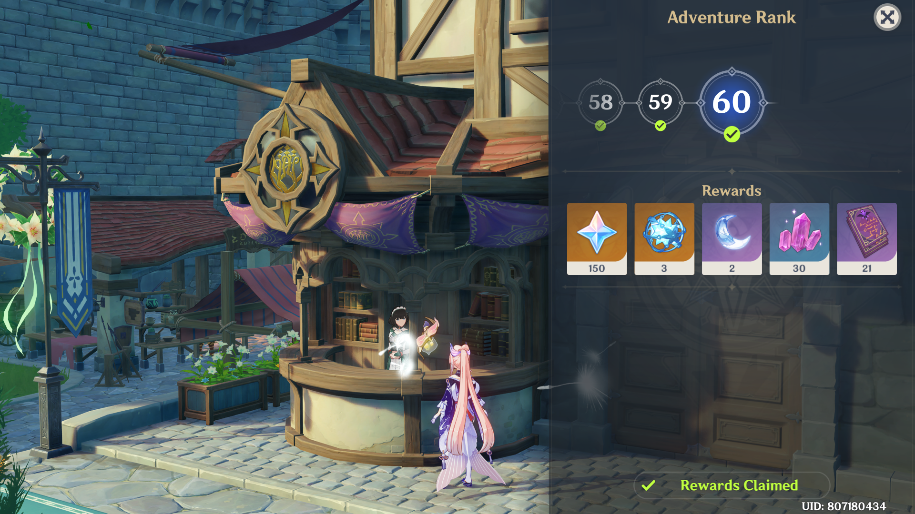
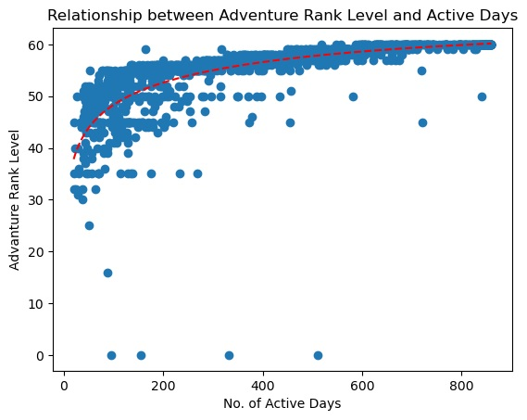
ADVENTURE RANK
Descriptive Statistics
Minimum | 0
Maximum | 60
Mean | 54
Max Possible | 60

Slide 5
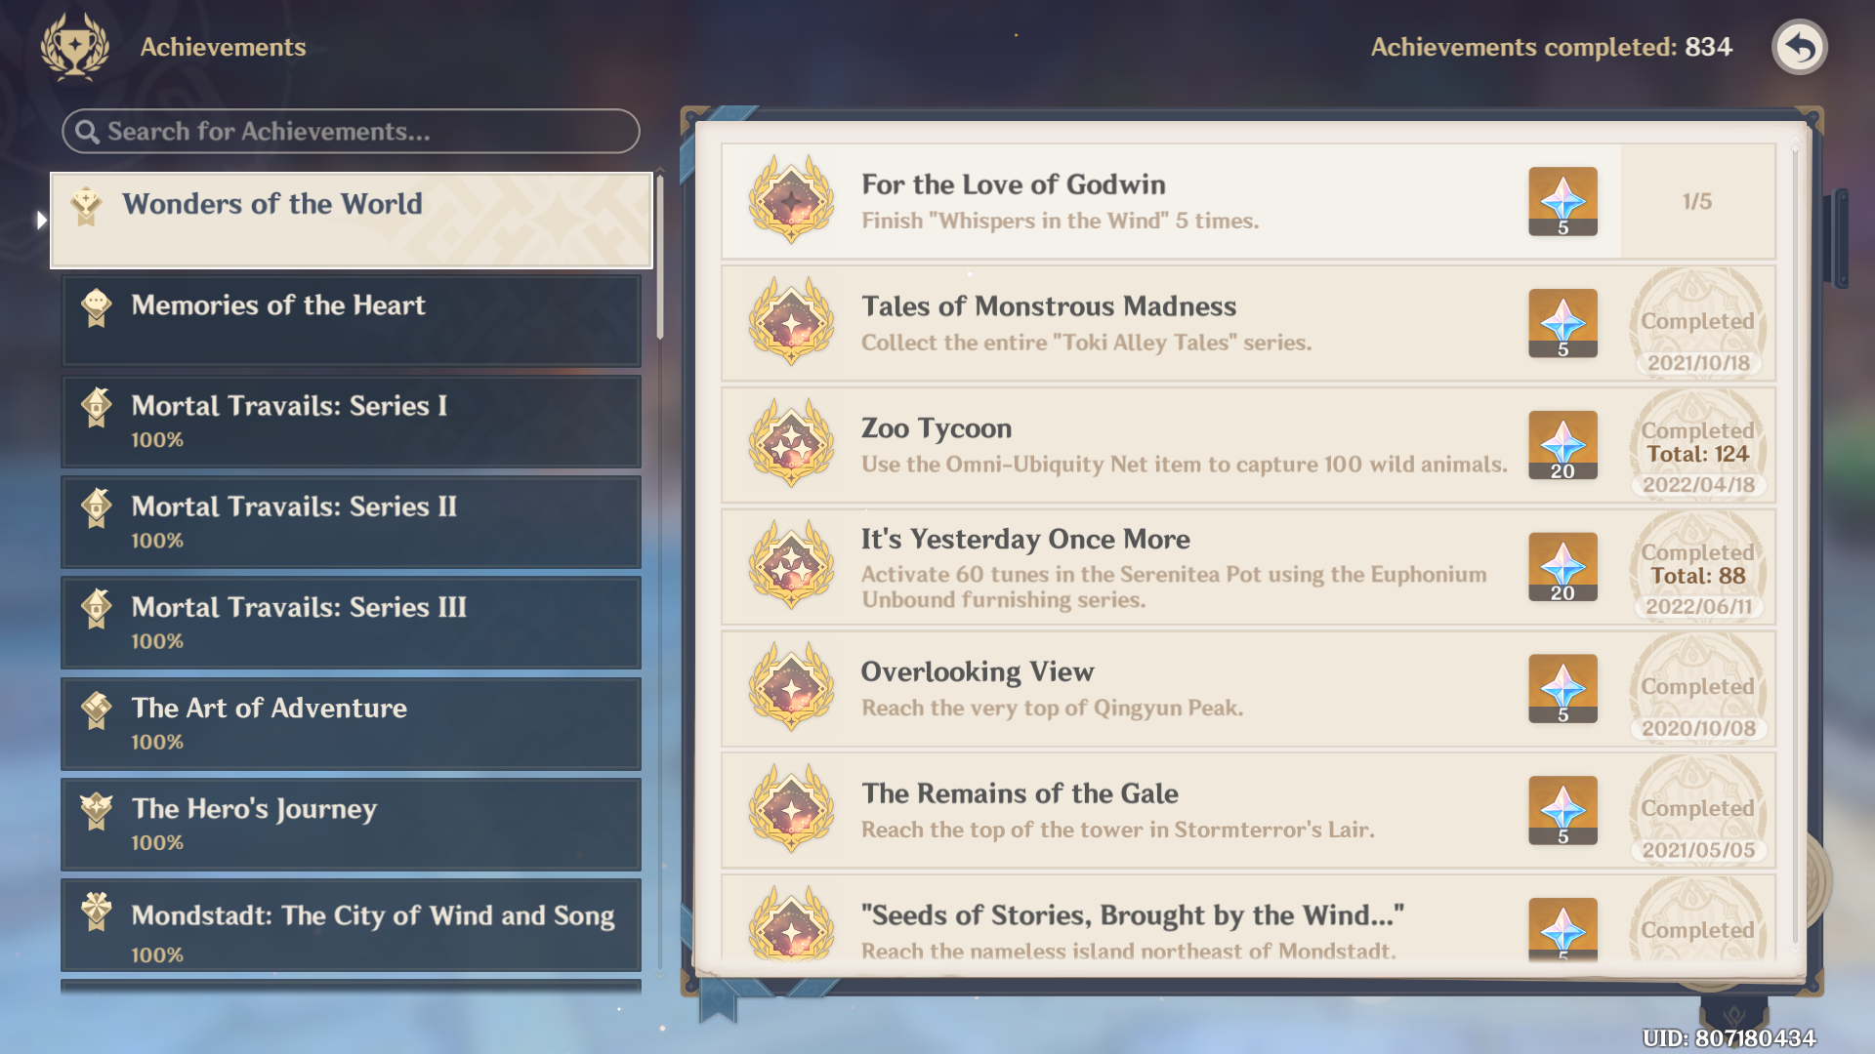
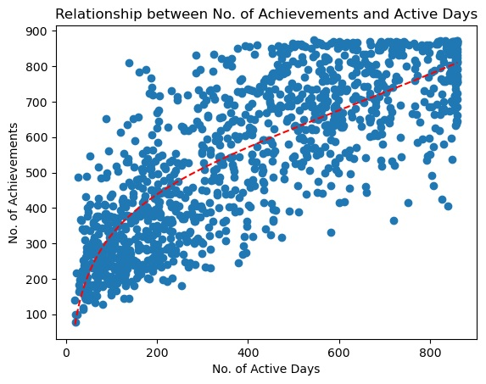
ACHIEVEMENTS
Descriptive Statistics
Minimum | 78
Maximum | 875
Mean | 542
Max Possible | 890

Slide 6
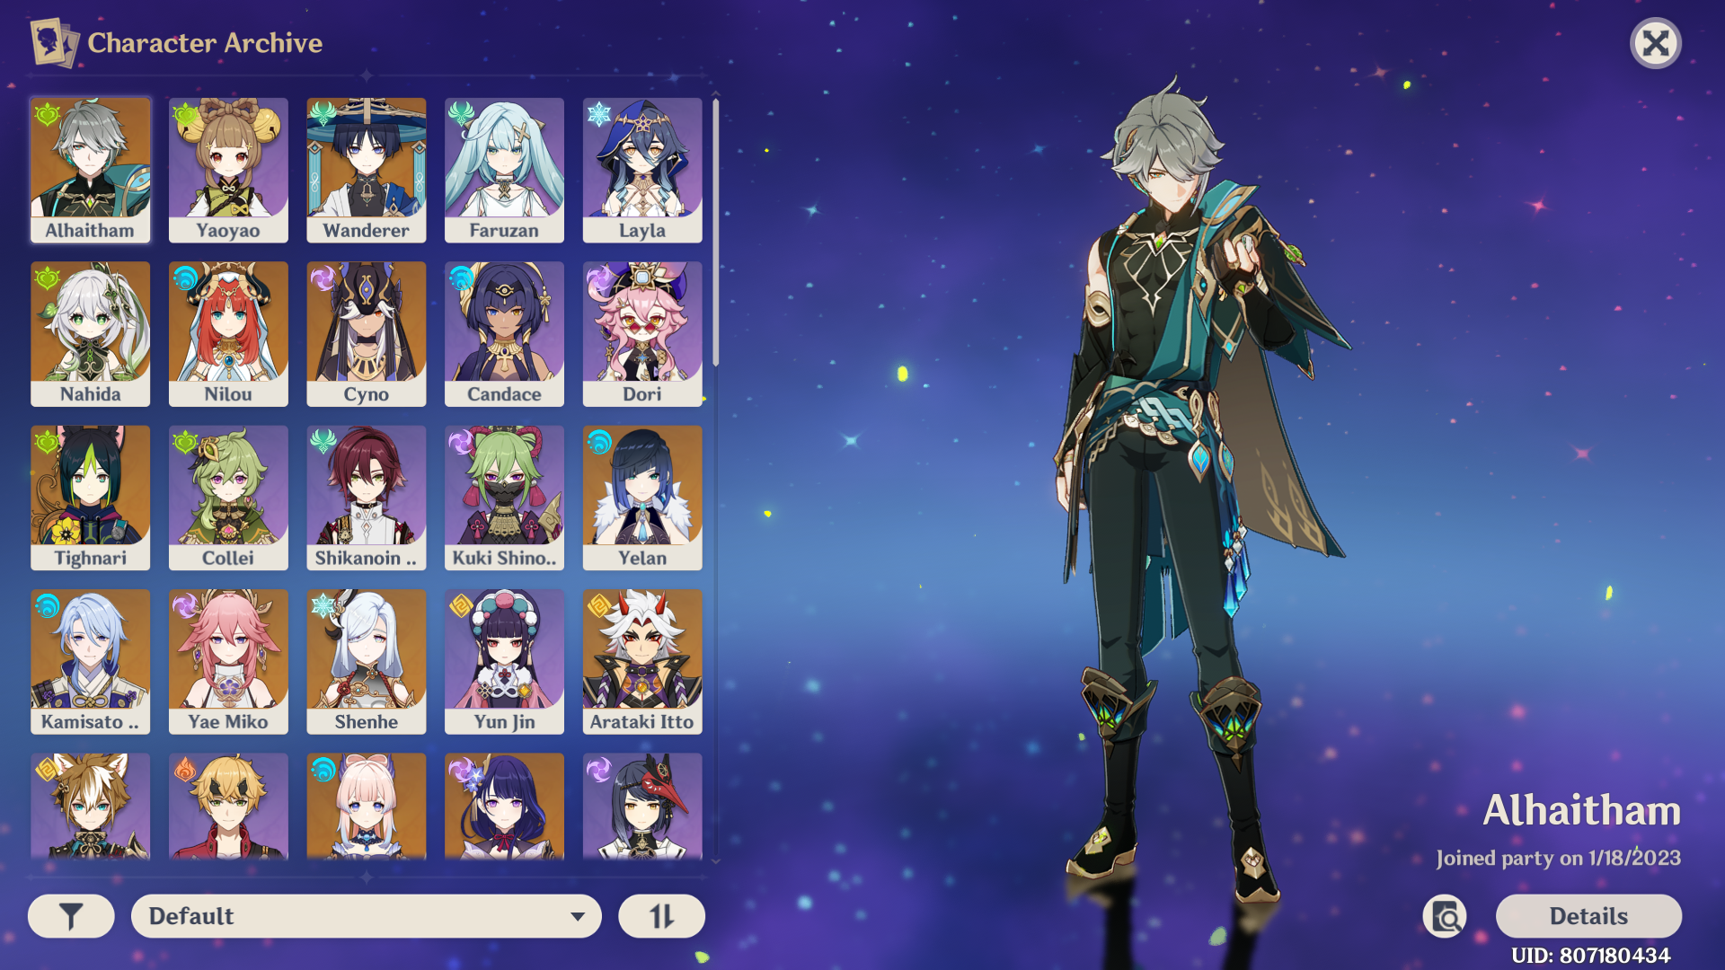
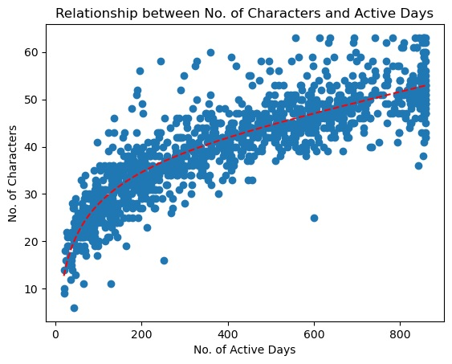
CHARACTERS
Descriptive Statistics
Minimum | 6
Maximum | 63
Mean | 40
Max Possible | 63

Slide 7
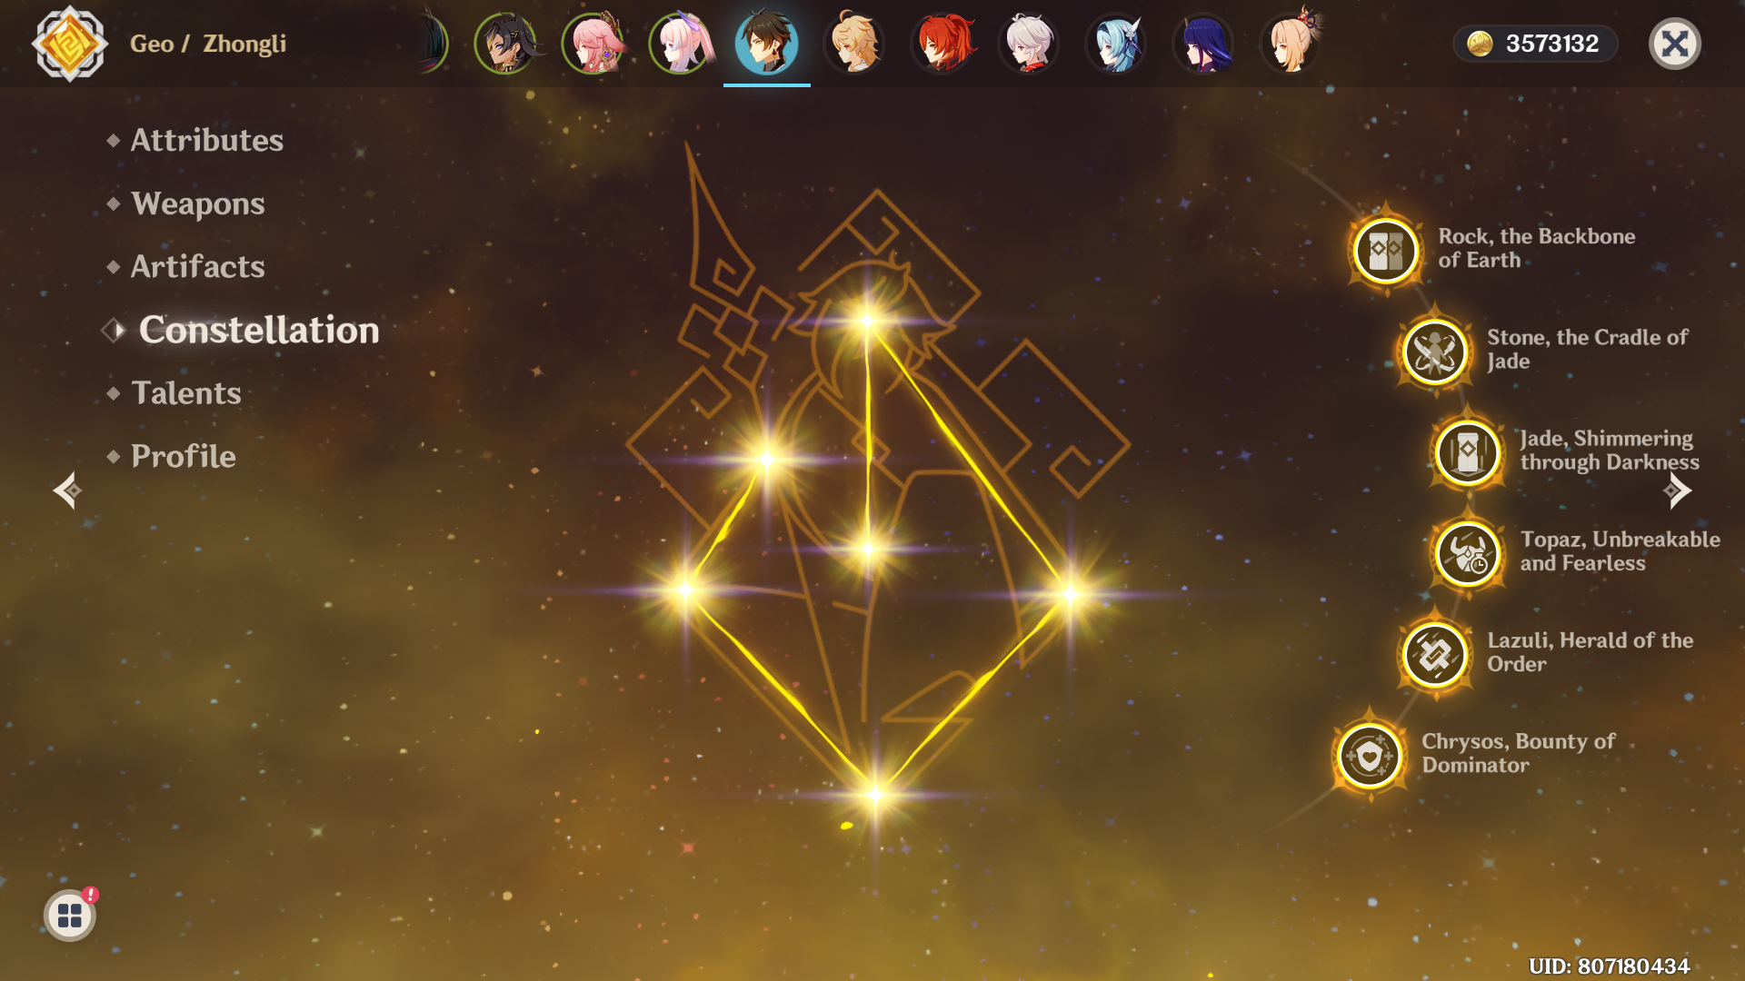
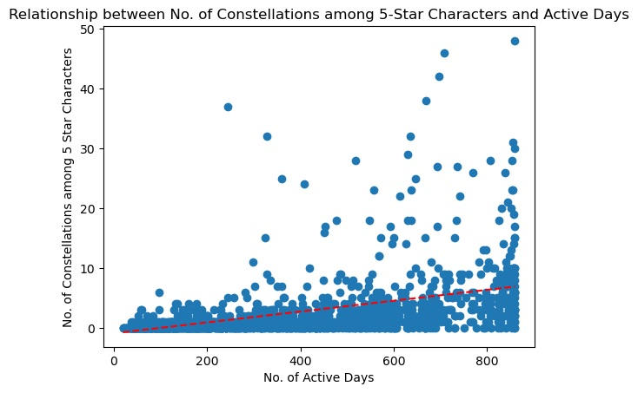
CONSTELLATIONS
Descriptive Statistics
Minimum | 0
Maximum | 48
Mean | 3
Max Possible | 48

Slide 8
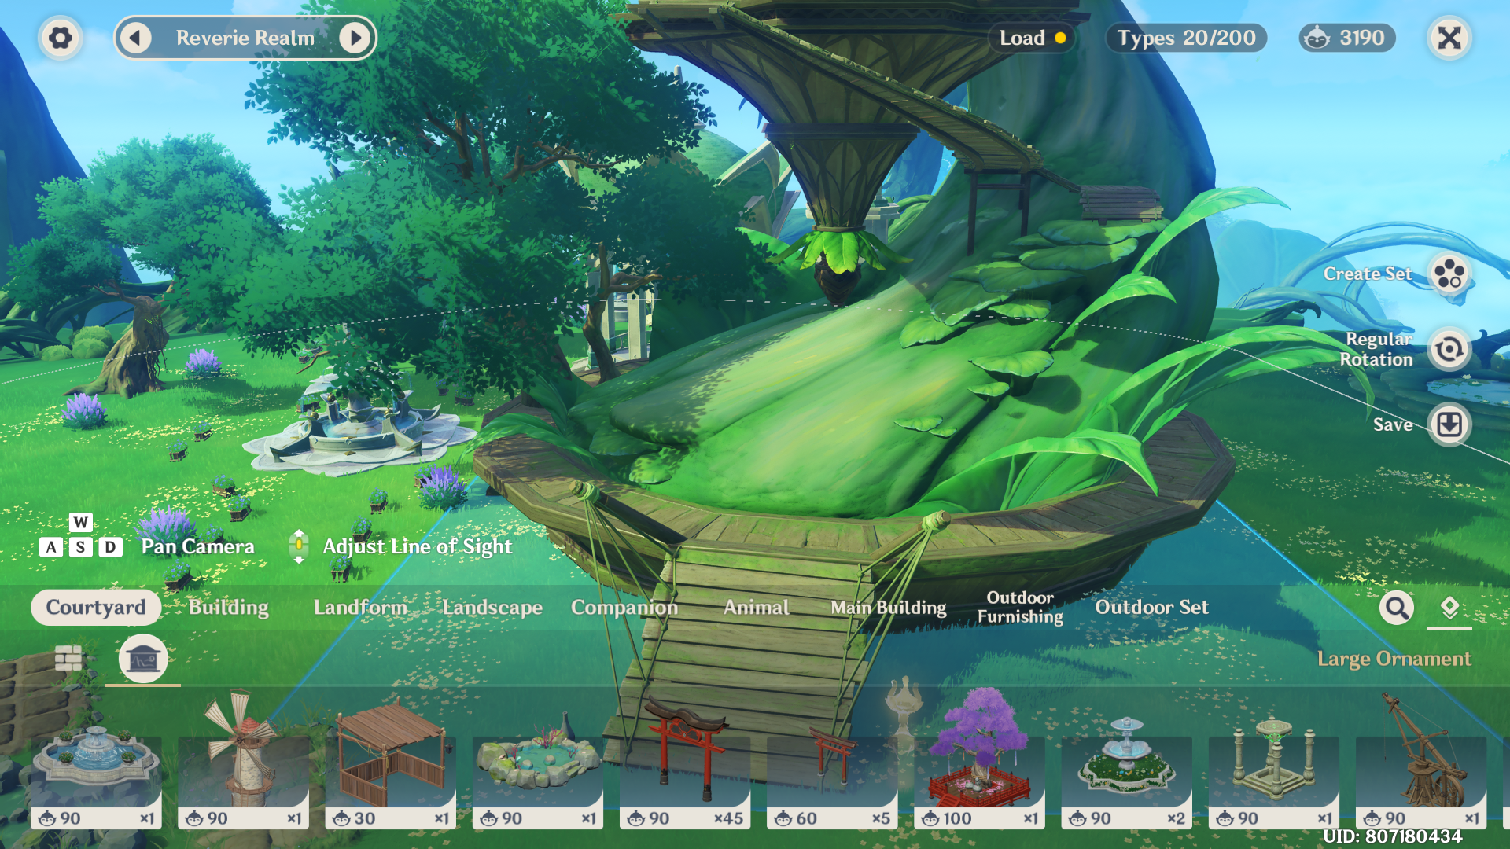
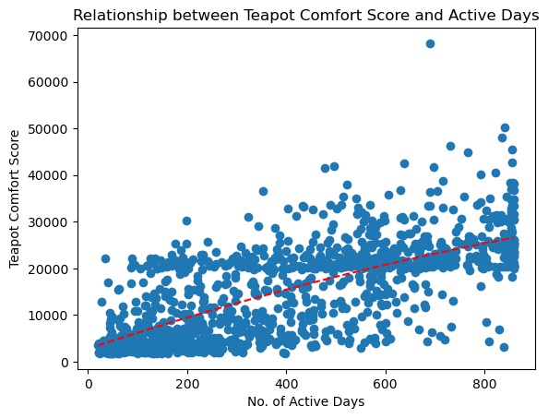
SERENITEA POT (COMFORT SCORE)
Descriptive Statistics
Minimum | 1,800
Maximum | 68,240
Mean | 15,019
Max Possible | -

Slide 9
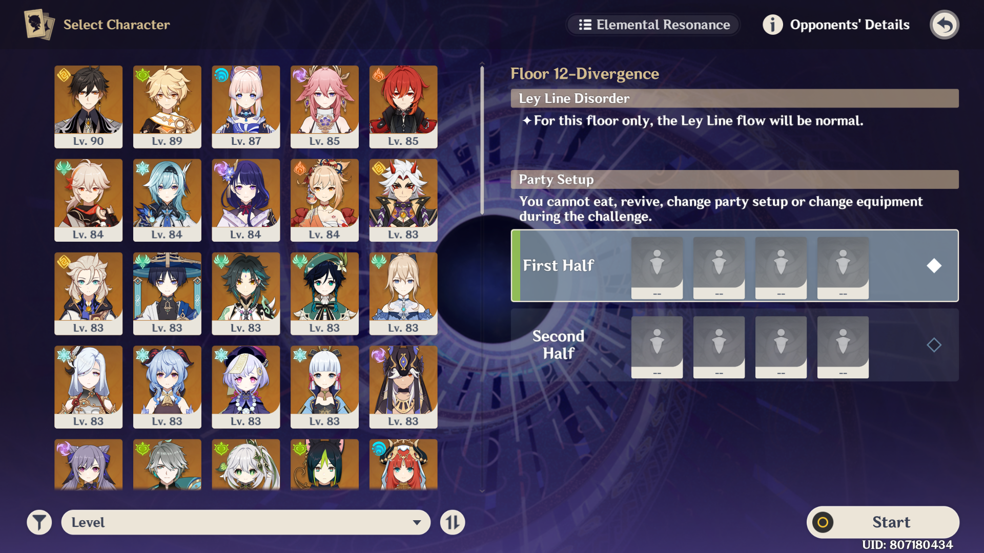
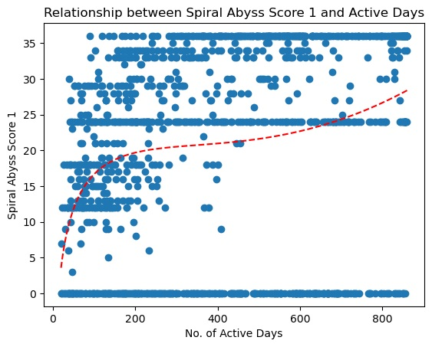
SPIRAL ABYSS
Descriptive Statistics
Minimum | 0
Maximum | 36
Mean | 21
Max Possible | 36

Slide 10
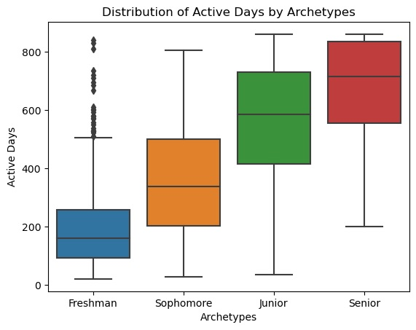
THE ARCHETYPES
Freshman | Sophomore | Junior | Senior
37.2% | 15.9% | 38.4% | 8.5%

Slide 11
THE ARCHETYPES (SUMMARY TABLE)
Variables | Freshman | Sophomore | Junior | Senior
active days | 092-258 | 203-495 | 414-586 | 557-840
level | 45-55 | 55-58 | 57-60 | 59-60
achievements | 240-406 | 394-628 | 628-872 | 750-875
characters | 26-36 | 34-46 | 42-50 | 45-54
5-star characters | 2-5 | 3-7 | 6-8 | 7-8
constellation among 5-star characters | 0-1 | 0-3 | 1-5 | 1-9
5-star weapons | 0-1 | 0-3 | 1-4 | 2-5
refinement among 5-star weapons | 0-1 | 0-3 | 1-5 | 2-6
total exploration score | 1890-3812 | 3596-6081 | 5781-6850 | 6577-6930
oculi | 168-355 | 332-542 | 492-613 | 562-613
common chests | 313-776 | 0732-1637 | 1555-2213 | 2074-2385
exquisite chests | 064-637 | 0582-1108 | 1129-1441 | 1472-1527
precious chests | 097-198 | 183-339 | 330-442 | 411-468
luxurious chests | 38-80 | 073-134 | 127-170 | 157-181
remarkable chests | 03-26 | 20-84 | 71-134 | 113-145
unlocked waypoints | 181-255 | 231-283 | 264-286 | 282-286
unlocked domains | 28-39 | 36-46 | 43-48 | 46-48
teapot visitors | 0-2 | 1-9 | 5-26 | 20-64
teapot comfort score | 2940-5630 | 10210-14990 | 20500-23510 | 30433-35425
teapot items | 099-293 | 422-862 | 0841-1721 | 1833-3027
teapot realms | 1-1 | 2-4 | 4-5 | 5-5
abyss score | 00-24 | 0-32 | 24-36 | 24-36

Slide 12
RECOMMENDATION: FRESHMAN
Freshman
37.2%
While Genshin Impact is not a complicated game, there are many useful tips that freshmen can pick up through social media and friends. Many started out watching Youtube or Twitch streamers or read online articles to pick up useful tips. One thing about Genshin Impact is that you could play this game entirely alone, therefore there isn't much pressure to know more people in order to progress in game. However, there are quite a few challenging content that might be easier if you pair up with experience gamers.

Slide 13
RECOMMENDATION: SOPHOMORE
Sophomore
15.9%
You probably covered quite a lot of the easy content and probably has to face the tougher ones. This is the stage when you start to develop deeper understanding of the game mechanism, such as choosing artifacts and planning team composition. There is a lot of useful information resources that can help you but don't be shy to ask people for advice. Sometimes, it is better to learn from friends than online resources. In some discord servers, there might be specific channel that provide help to gamers. If you have not ventured into Spiral Abyss, it may be worthwhile to try it out. It takes a while to move up the floors, so don't be disappointed if you cannot clear everything in one go.

Slide 14
RECOMMENDATION: JUNIOR
Junior
38.4%
The distinction between Juniors and Seniors, beside number of active days, Seniors just have everything more and done more than Juniors. Perhaps you have come to terms with some of the achievements which are rather painful (e.g. fishing and growing crops in the teapot), you have decided to finish it or give it up totally. There is probably no hurry to rush them through unless you really want those free primogems. You probably want to take your time to venture the remaining content, otherwise, you might end up like the Seniors with very little left to do.

Slide 15
RECOMMENDATION: SENIOR
Senior
8.5%
Senior have been supporting the game and have played out most, if not all the content that is available. They are up to date with the latest content and hungry for me. Probably at some time, or already so, you might stop for a while or slow down, or perhaps find that friends who have been playing the game no longer do so. There is probably a time when you might move on with the game and do something else. The main point is that you have enjoyed the game and have many happy moments, and if you continue to do so, may you have many more happy memories in the future. When there is free time, Seniors are excellent in helping others in challenging content.

Slide 16
REFLECTION
BUSINESS IMPLICATION
Profitability
Longevity
No Spending
Light Spending
Heavy Spender
New Players
Lapsed Players
Active Players
Experience
Freshman
Sophomore
Junior
Senior

